Slide 1
Amazon Laptop Market Analysis Using Scraped Data
Name : Harshita Sahu
Date : 19/01/2026

Slide 2
Business Objective
The objective of this project is to analyze Amazon laptop sales data to identify key drivers influencing customer purchasing decisions.
Using scraped data of top 100 Amazon laptops, this analysis focuses on Lenovo products to compare pricing, ratings, processor types, and sales performance.
The goal is to help businesses and customers understand:
What is the driver force of sales.
Comparison between different laptops.
Which laptop series offers the best value for money.
Which processor types and price categories drive higher sales.
How ratings and reviews influence quantity sold.
Which product features contribute to higher customer preference.

Slide 3
Data Extraction & Preparation
The top 100 laptop products were scraped for analysis.
Data was extracted from the Amazon website focusing on Lenovo laptops using Selenium in a Jupyter Notebook.
Detailed product information was extracted by navigating into each product URL using loops and collecting all available attributes.
Initially, around 67 columns were extracted. After data cleaning and removing irrelevant or redundant fields, the dataset was reduced to 42 meaningful columns.
Various data cleaning and transformation steps were applied to make the data analysis-ready.
The final cleaned dataset was exported to CSV format and further analysis and visualization were performed using VS Code and Streamlit.

Slide 4
Data Overview & Data Structure
Data Summary
Final dataset contains 42 columns and 100 Lenovo laptop records
Data includes:
Product information
Pricing & discount details
Ratings and review counts
Sales-related metrics
Key Data Categories (VERY IMPORTANT)
This shows business understanding.
Example content:
Product Details: Title, Series, Model Number
Pricing Information: Price, Discount %, Price Category
Sales Metrics: Quantity Sold Last Month
Customer Feedback: Ratings, Rating Count
Technical Specifications: Processor Brand, Processor Type

Slide 5
Business Problem Statement
1) What drives laptop sales?
Do price, discounts, ratings, or product features influence sales the most?
Is sales performance driven by a single factor or a combination of multiple factors?
2)Which products have untapped sales potential?
Are there products with high ratings and review counts but low sales, indicating strong quality but poor visibility or pricing?
Are there products with lower ratings but high sales, suggesting demand driven by price or brand?
Which products have the potential to increase sales with better positioning?
3)Which product features are most preferred?
Which processor brands or processor types are sold the most?
Which laptop series show higher customer demand?

Slide 6
Business Problem Statement
Which features consistently appear in high-performing products?
4)How do products compare against each other?
How do two laptops differ in terms of:
Price
Sales volume
Ratings and reviews
Discounts and specifications
Which product offers better value for money?

Slide 7
Key Performance Metrics
Metrics | Values
Most sold Laptop | Lenovo | IdeaPad Slim 3|15IAH8|Core i5||512 GB|SSD15.6 Inches
Most sold Series | IdeaPad Slim 3
Most sold model number | 15IAH8
Top1 Price Categories | Medium
Top1 Processor brand | Intel
Top1 Processor Type | Core i5

Slide 8
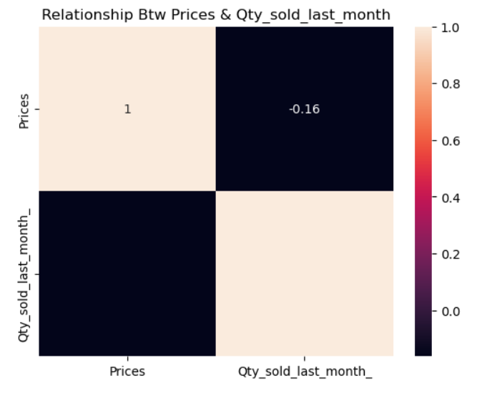
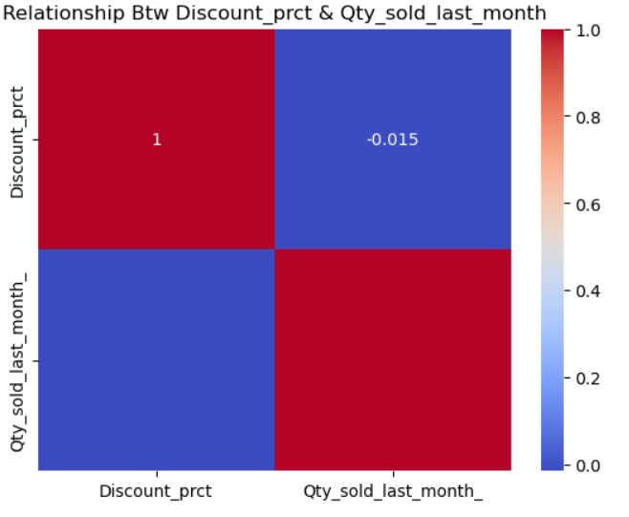
Key Drivers of Sales
There are some Numeric features which may or may not be a sole driver of sale.
Relationship btw Prices & Qty sold last month.
As the heatmap is showcasing there is a negative low correlation of -0.16.
That depicts is the prices increase of fall there is no such increase in Qty sold of Laptops .
2)Relationship btw Discount percentage & Qty sold last month.
There is a -0.015 as correlation between these two .
That depicts that if discount increase or decrease there is no such effect on our quantity of laptop being sold

Slide 9
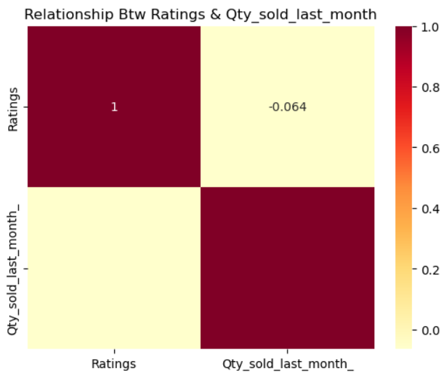
Key Drivers of Sales
3) Relationship between Ratings and Qty sold last month.
There is a negative low correlation of
-0.064 which depicts that ratings also not impacting or creating any significant impact on sales .
***Overall Insight***
These analyses are based on last month’s sales data. To identify long-term sales drivers, additional correlations were examined between:
Rating Count & Price
Rating Count & Discount
Rating Count & Ratings
However, all these combinations also showed weak or negligible correlations.

Slide 10
Why Single Metrics does not give a True Picture
“We can’t solely depend on Rating Counts as there records which can be historical data collected from several years that does not give us a real picture of laptops which are being sold then with the current trends
Also, can’t depend on Qty sold Last month to make our analysis and predict which one is more demanded or which one is not
We need to consider both these columns to make our analysis real and dependable”
Now we are moving towards Laptops features

Slide 11
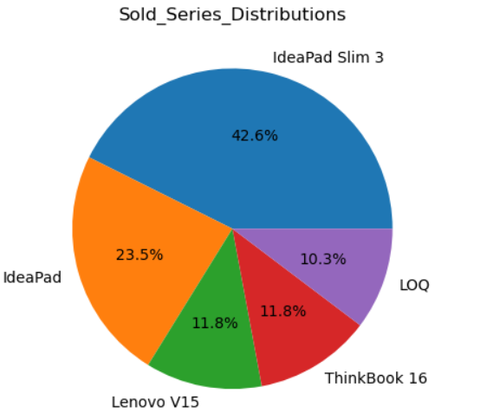
Key Drivers of Sales
As numeric columns does not give a real picture of key driver of sales it depicts that the sales is driving by the combination of various categorical features like processor type , series , processor brand.
Quantity sold by series Distribution
The most sold series is IdeaPad Slim 3 about 42.6% of these series are being sold among the whole series
The least sold one is LOQ which is about 10.3%
So, the series is one of the driver of sales.

Slide 12
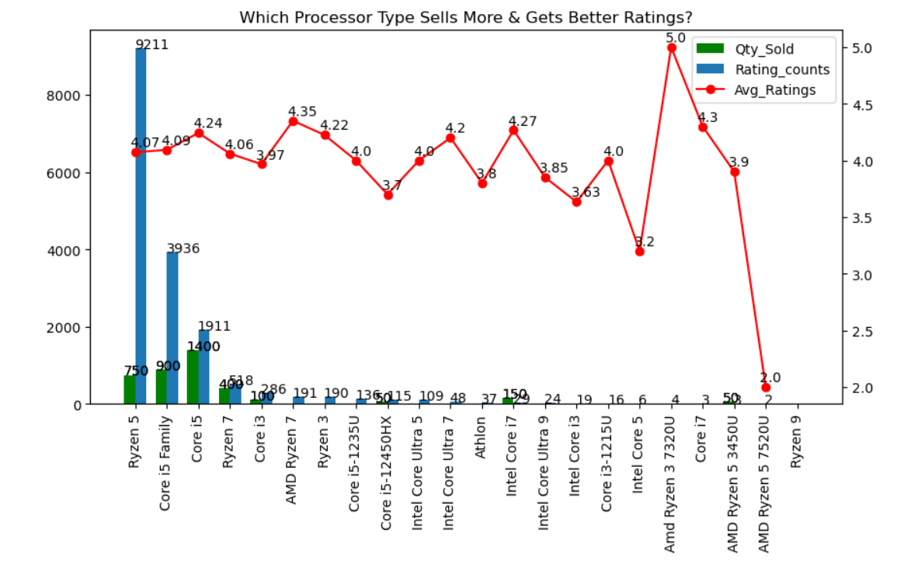
Key Drivers of Sales
The processor type core i5 is sold the most with 1400 sales In just last month with rating counts having rating as 4.24.
As per the Rating counts the Processor Type Ryzen 5 rated the most which we can say sold the most in past having ratings of 4.07 which can be improved
When both metrics are considered together recent sales (Qty Sold Last Month) and historical popularity (Rating Counts) a shift in consumer preference is observed.
Emerging Trend: Consumers are gradually moving towards Ryzen 7, showing higher interest compared to Core i5, which indicates a transition toward higher-performance processors.

Slide 13
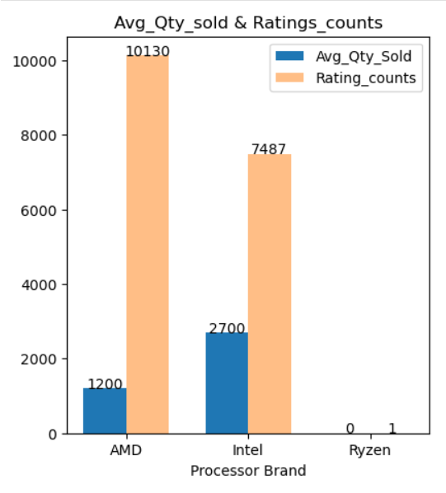
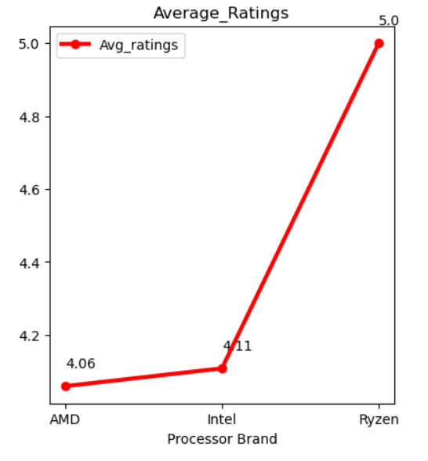
Key Drivers of Sales
The Processor Brand AMD contributes more in terms of Historical sales with an average rating of 4.06.
According to Qty sold last month the Intel sales is higher than AMD which only depicts the consumer behavior shift to a better processor .
The Ryzen is doing nothing as only 1 rating counts is there with 5.0 as ratings which does not contributing anything .
So, we can conclude the customer are shifting form AMD processor brand ---> Intel Processor Brand

Slide 14
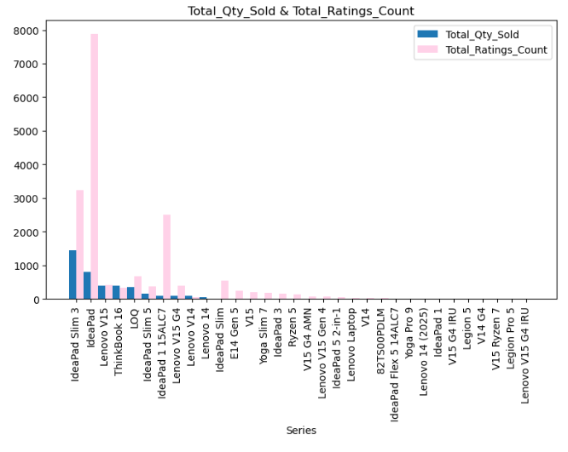
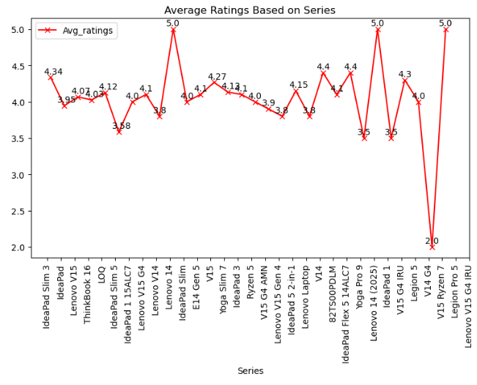
Key Drivers of Sales
The Historical Data Depicts the series Idea Pad contributes the most then the Idea Pad Slim 3
According to last month Qty sold the Idea Pad Slim 3 contributes the most in sales which shows same a shift of consumer preference from IdeaPad to IdeaPad Slim 3
In case of average rating also the rating of Idea Pad slim 3 ----> 4.34 but in case of Idea Pad it is ----> 3.95.
The Ratings also seems less due to quality upgrade that can be a reason of customer to shift to Idea Pad Slim 3 Series .

Slide 15
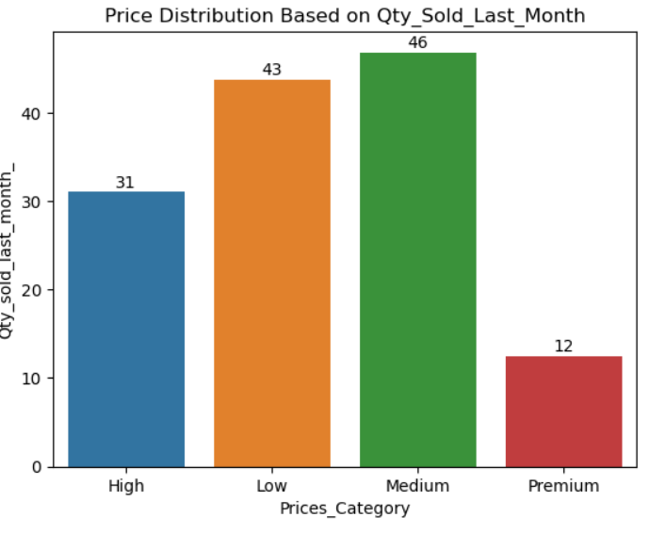
Price Distribution Based on Qty Sold Last Month
The all analysis which I have done in above pages it only shows the shift in customer preferences .
Low price category ranges from 30,000 to 40,000
Medium Price Category ranges from 40,000 to 60,000
High Price Category ranges from 60,000 to 90,000
Premium Price Category above 90,000
This chart clearly depicts that Medium Price category contributes the more compared to Low Price Category .
As we already seen that there is very low correlation between price and qty sold the customer are not getting much influenced by prices .
This shift in customer preference is only because of customer not minding much in investing in medium price category as they are getting better feature compare to Low price Category.

Slide 16
Early Products Warning for Future Demand
Titles | Average ratings | Total Ratings count | Total Qty Sold
Lenovo | IdeaPad Slim 5|16IMH9|Core i5|16|1 TB|SSD16 Inches | 3.3 | 178 | 100
Lenovo | ThinkBook 16|21MWA0AUIN|Ryzen 7||512 GB|SSD16 Inches | 3.6 | 82 | 200
Lenovo|LOQ|15IRX9|Intel Core i7||512 GB|SSD15.6 Inches | 3.6 | 4 | 100
Lenovo|LOQ|15IAX9|Core i5-12450HX||512 GB|SSD15.6 Inches | 3.7 | 115 | 50
Lenovo|Lenovo V14|83A0A0PBIN|Core i3||512 GB|SSD14 Inches | 3.8 | 59 | 100
These are the Top 5 Products of Lenovo which are at high risk of not being continued in future.
The reason behind they can be discontinued is that Average ratings of these products are low but the quantity sold last month is high which only indicate that customer are not liking the quality and this can be a reason behind product of discontinuation.

Slide 17
Golden Products chances of Future Demand
Titles | Average ratings | Total Ratings count | Total Qty Sold
Lenovo | IdeaPad Slim 3|15IRH10|Core i5||1 TB|SSD39.6 Centimetres | 4.4 | 128 | 200
Lenovo | IdeaPad Slim 3|15IAH8|Core i5||512 GB|SSD15.6 Inches | 4.4 | 534 | 900
Lenovo|LOQ|15ARP9|Ryzen 5||512 GB|SSD15.6 Inches | 4.2 | 109 | 50
Lenovo | IdeaPad Slim 3|14IRH10|Core i5 Family||512 GB|SSD14 Inches | 4.1 | 1640 | 200
Lenovo | IdeaPad Slim 3|15IRH10|||512 GB| | 4.1 | 410 | 100
These are the top 5 products which can be consider as golden products.
The reason behind these products can be considered as golden products as the average ratings as well as total ratings count is high but the Total qty sold is low . But there is a golden opportunity behind these products can be consider as profit making products .

Slide 18
Challenges Faced During Data Collection & Preparation
The target website (Amazon) is dynamic and non-static, making traditional scraping methods ineffective. → Selenium was used to handle dynamic content loading.
The website implemented anti-scraping mechanisms, frequently blocking requests and limiting data extraction. → As a workaround, scraping was restricted to a maximum of 100 laptops per run to avoid blocking.
Scraping all products from specific brands (e.g., Lenovo) was challenging due to frequent request throttling and page restrictions.
Extracting detailed product information required navigating individual product pages. → Creating a common XPath was difficult due to inconsistent page structures.

Slide 19
Challenges Faced During Data Collection & Preparation
To handle this, multiple attributes, keys, and conditional logic were used to build flexible XPath expressions that worked across different pages.
Product specification tables were extracted as key-value pairs, then combined, cleaned, and standardized into a consistent format.
The cleaned and structured data was consolidated into a single DataFrame, which was then used for exploratory analysis and visualization.

Slide 20
Thank You

